Slide 1
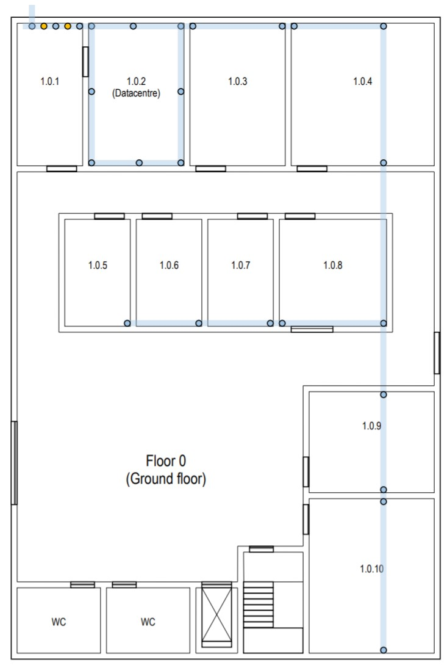



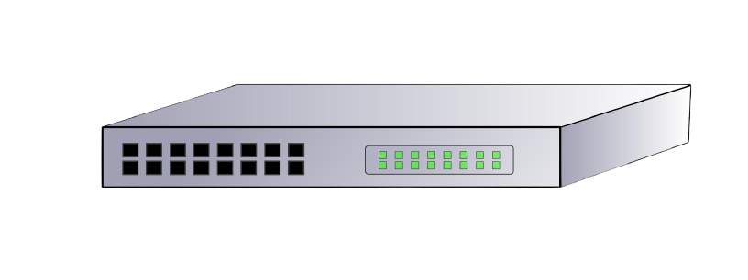



Slide 2
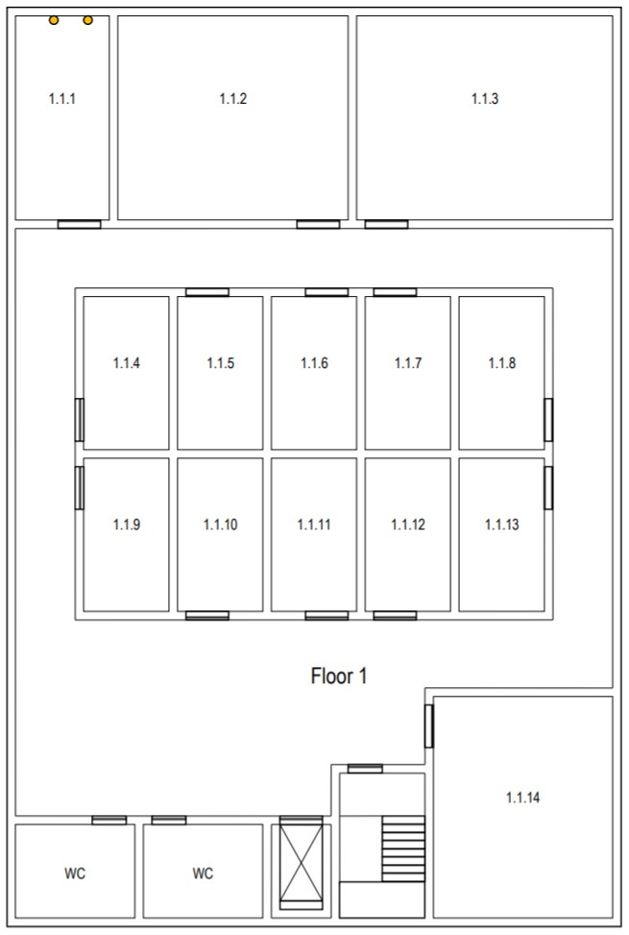

Slide 3
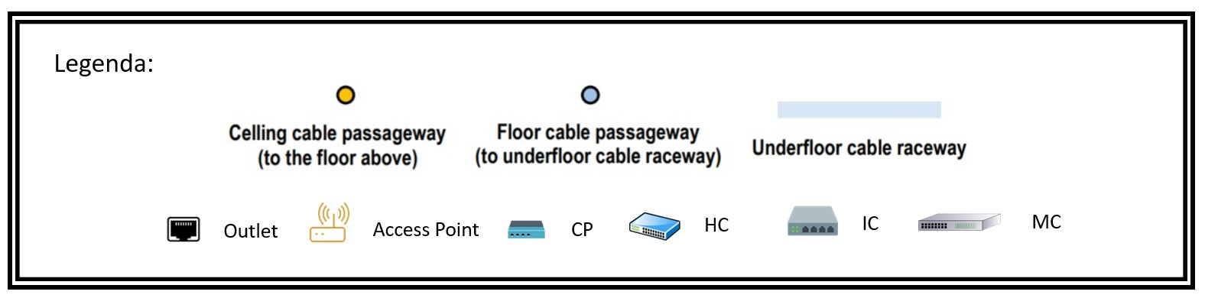
CAT 7 copper cable
CAT 7 copper cable - underfloor
Optical Fibre
Optical Fibre – underfloor
Range AP

